Slide 1
From Networking to Streaming
Debo@Cisco

Slide 2
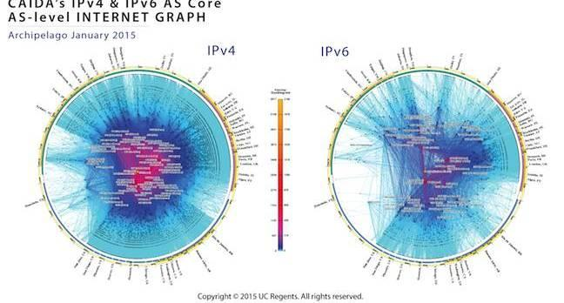
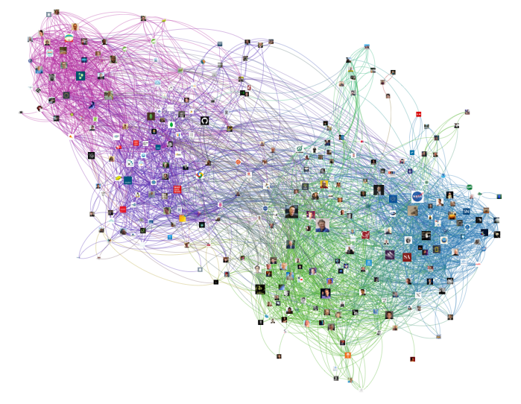
What is Networking?
“Connect” two end-points or entities (x,y)?
IP addresses
People
Protein interaction
Example: Transfer a bag of bits (BoB) between x and y
How do we “connect”?
What are switches and routers?
What functions are performed by them?

Slide 3
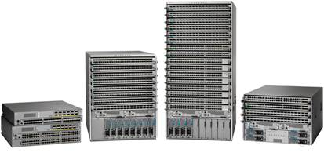
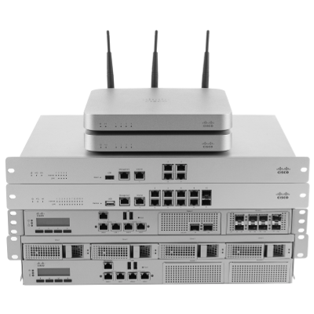
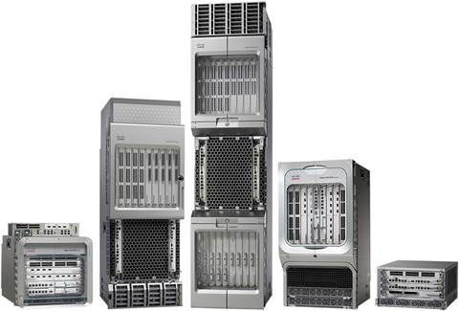
Switches and Routers
Apply f(x) on BoBs
Routing = Table lookup f(ip)
Switching = Table lookup f(mac)
VPN = f(header, rules)
Thesis = stream engines
Evaluate functions
Often have little state (bloom filters, lookup tables)
Often care about timeliness

Slide 4
Preliminaries

Slide 5
What is Stream Processing
Bounded data = batch
Large volumes of weblogs
Financial transactions over 1 year
Unbounded data = streaming
Sensors (Nest, GE, Marvell)
IP packets, Netflows
Tweets, Likes, Activites
Video streams (Nest cam)
Y = f(X), where X is “time stamped”
Event time
Processing time (or Wall clock time)

Slide 6
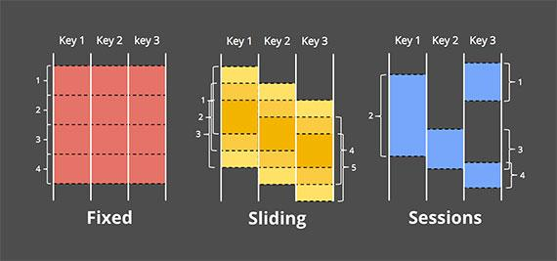
Bounding Streams
Fixed Window
Slice time into segments
Sliding Window
Generalized window
<Length of window, Shift>
Sessions
Dynamic window with timeouts
All web-traffic for user ‘i’ during the NFL game
Unaligned windows

Slide 7
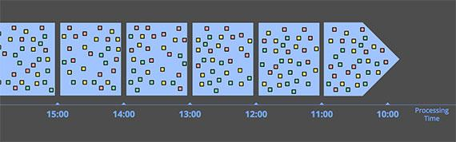
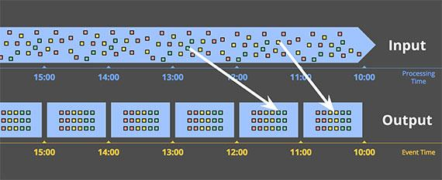
Windowing Strategies
Windowing by processing time
Windowing by event time

Slide 8
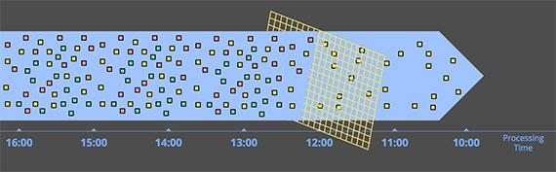
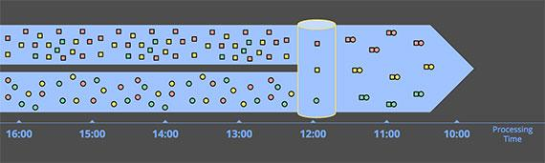
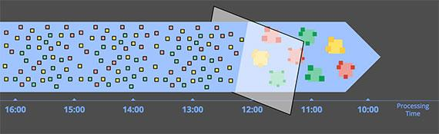
Time Agnostic Streaming
Data driven processing
Filtering
Y=f(X)
Inner Joins
Given 2 unbounded streams
Only emit when the other element arrives
Persistent store
Age un-joined data
Derivative Streams
TopK
Clustering
Anomaly detection

Slide 9
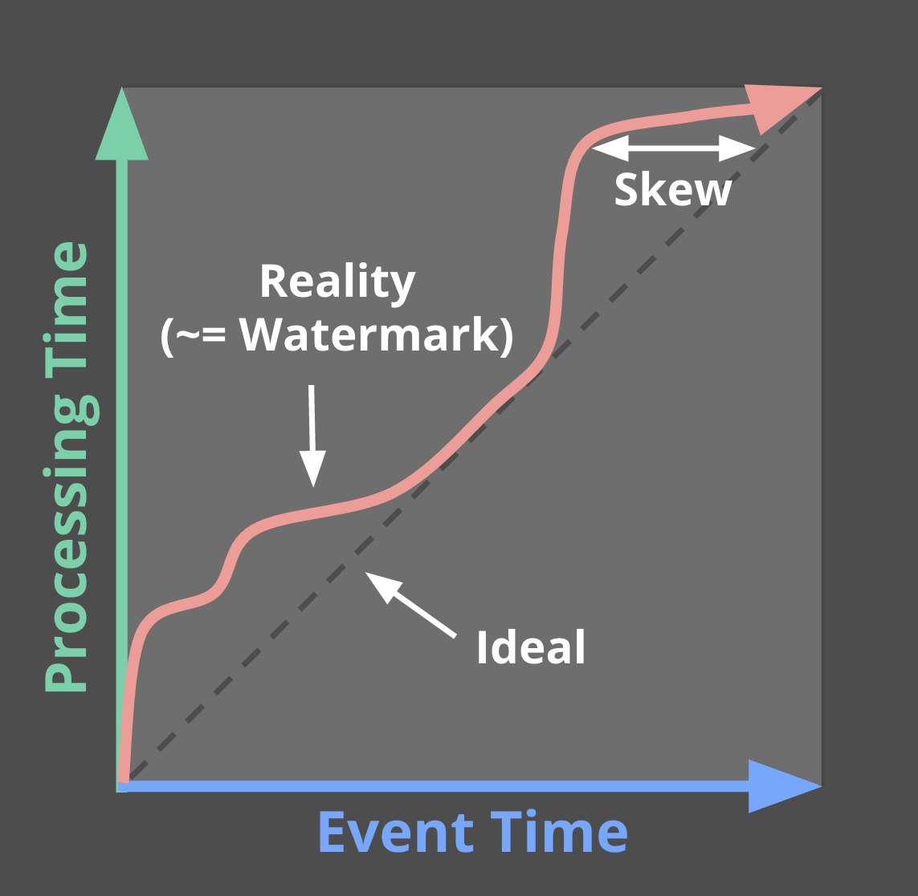
Four questions for every stream processing job
What results are calculated?
Where are the results calculated (event time)?
When do you get the results (processing/wall-clock time)?
How do we refine the results (discarding, accumulating, accum/retract)?

Slide 10
Streaming Algorithms

Slide 11
Example 1: Distributed Priority Q
Given a priority Q, PQ, that needs to track priorities of N elements where M=memory of a compute node, and N>>M
E.g. priorities on temperature readings, or scores on tweets (based on their rank etc)
Recall what a priority Q is
Insert into PQ q.insert(x, prio)
Peek into PQ q.peek()
Extract element with max priority q.extract_max()
Hints
You will need at least N/M machines
Maybe also a master machines
Assume there is a library available for immutable PQs written in your favorite language

Slide 12
Solution Steps (Insert)
Insert(x)
We have n=N/M slaves keeping track of M elements each in a PQ
We have a master node that keeps track of the min (or max) of each PQ
Upon arrival: hash element x into [1..n] i.e. i=hash(x)
Then insert x into the i-th PQ
If x is the new min of the i-th PQ, master PQ needs to be updated
Insert x into the master PQ after extracting the min
master
1
i=hash(x)
n=N/M

Slide 13
Example 2: Clustering Logs
Consider logs in a streaming fashion arriving from hundreds of machines at an aggregated point
Log: a line of text with a timestamp and a message (like a tweet from a machine)
Think of a log entry = JSON object with timestamp as a key/val pair
Problem: group similar logs and color code them i.e. for all log entries
Algorithm needs to be fast
A simple idea:
Using a sliding window and define a microbatch size
Within a batch, run a clustering algorithm of your choice
Question: what is a simple and decent clustering algorithm?

Slide 14
MinHash
Let H be a hash function such H(A) lies between [0,1], thus each a_i is hashed to H(a_i), thus H(A)={for all i, H(a_i)}
Min(H(A)) is a good descriptor for A, since the probability of the min changing lies between 1/(|A|+1) and 1/|A|. Why?
Now what is the probability of Min(H(A)) = Min(H(B))?
The probability of the min hashes being equal is the same as the min occurring in both A, B and is |AxB|/|A+B|!
Fudge: if you have a minHash, how will you find similar sets. Assume you can convert tokens to sets.

Slide 15
SimHash
Idea = if we can hash a set of tokens/objects into a k bit fingerprint s.t.
2 sets that are similar should have very low hamming distances
Then we could compute similarity easily by performing bit ops on their fingerprint
If we tune the size we can also have each fingerprint represent a cluster
def simhash(tokens, hashbits=64):
v = [0]*hashbits
for t in [string_hash(x) for x in tokens]:
bitmask = 0
for i in xrange(hashbits):
bitmask = 1 << i
if t & bitmask:
v[i] += 1
else:
v[i] -= 1
fingerprint = 0
for i in xrange(hashbits):
if v[i] >= 0:
fingerprint += 1 << i
return fingerprint

Slide 16
The pseudo-clustering step
Find SimHash for every log entry
For all items with the same SimHash, assign the same cluster ID.
One pass algorithm
Anecdotes: algorithm works on very large sets (at web scales)
Examples of locality sensitive hashing
Folks got ACM award for this!

Slide 17
Building Blocks

Slide 18
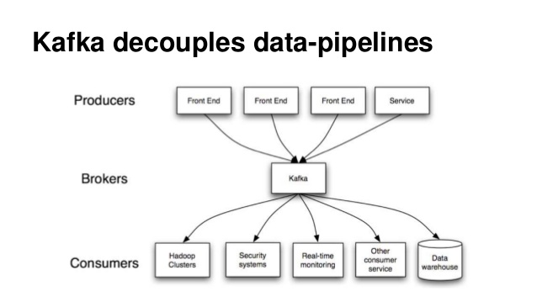

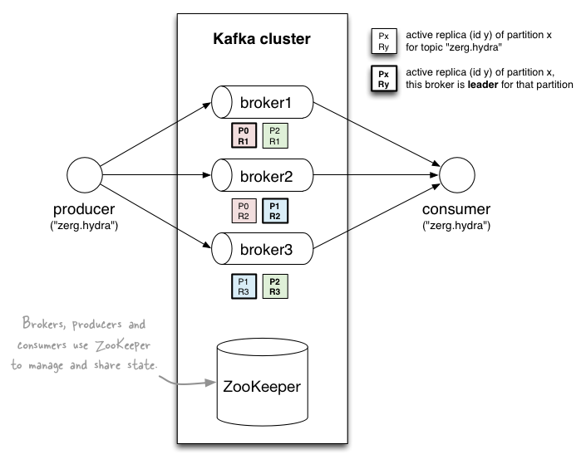
class Producer(threading.Thread):
daemon = True
def run(self):
producer = KafkaProducer(bootstrap_servers='localhost:9092') while True:
producer.send('my-topic', b"test")
producer.send('my-topic', b"\xc2Hola, mundo!")
time.sleep(1)
class Consumer(threading.Thread):
daemon = True
def run(self):
consumer = KafkaConsumer(bootstrap_servers='localhost:9092',
auto_offset_reset='earliest')
consumer.subscribe(['my-topic'])
for message in consumer:
print (message)

Slide 19

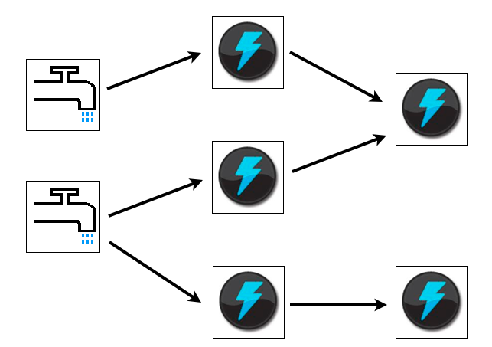
TopologyBuilder builder = new TopologyBuilder();
builder.setSpout("spout", new RandomSentenceSpout(), 5);
builder.setBolt("split", new SplitSentence(), 8).shuffleGrouping("spout");
builder.setBolt("count", new WordCount(), 12).fieldsGrouping("split", new Fields("word"));
public void execute(Tuple tuple,
BasicOutputCollector collector) {
String word = tuple.getString(0);
Integer count = counts.get(word);
if (count == null)
count = 0;
count++;
counts.put(word, count);
collector.emit(new Values(word, count));
}

Slide 20
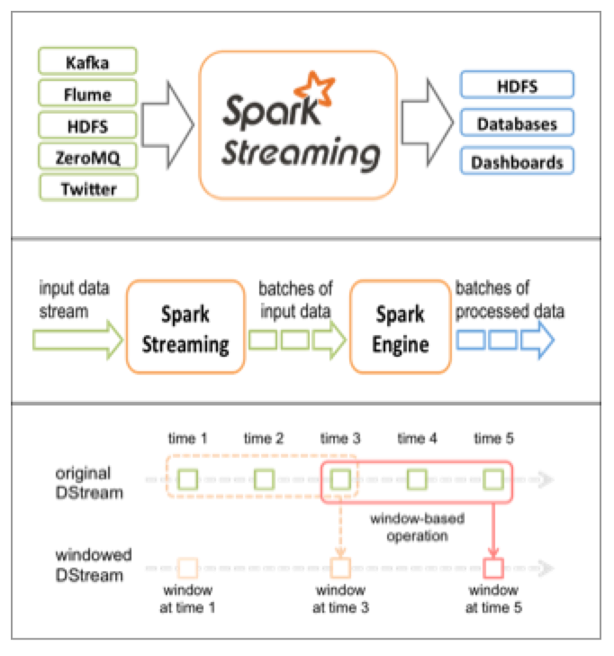

Slide 21
Data Pipelines

Slide 22
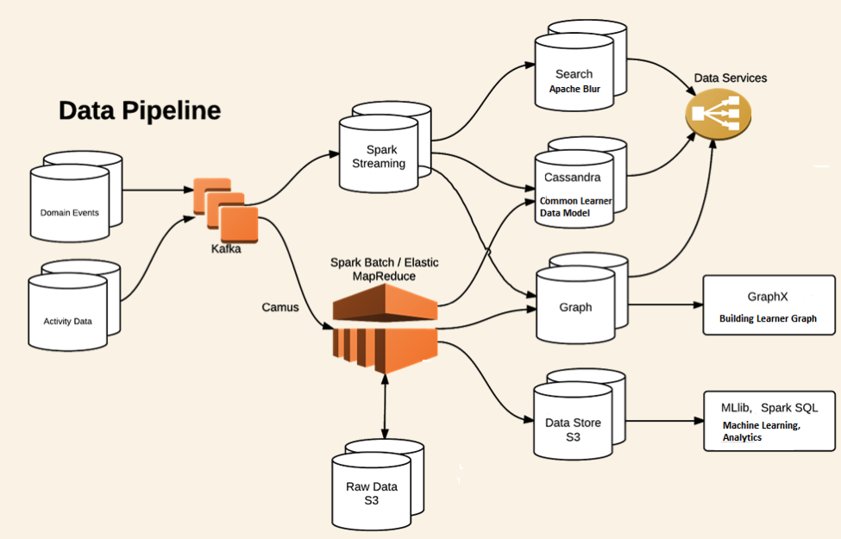

Slide 23
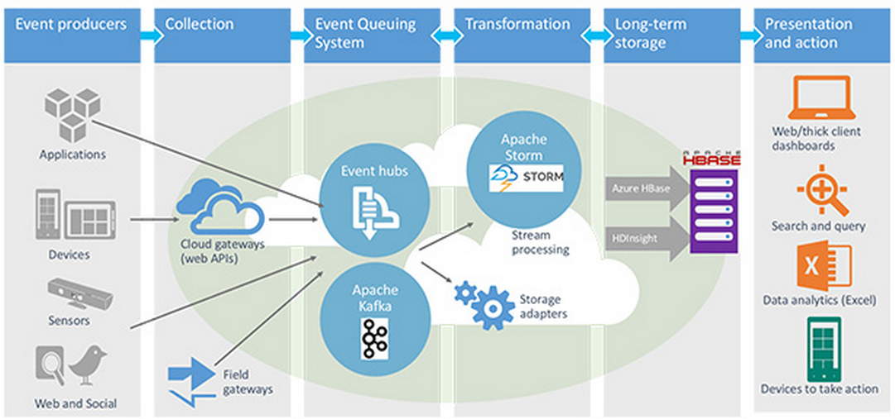
Even enterprises have embraced Streaming

Slide 24
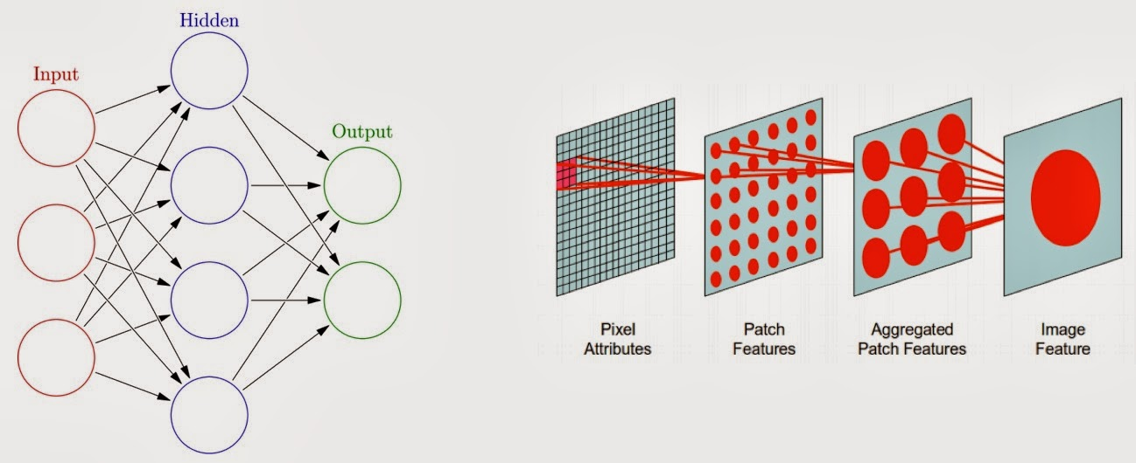
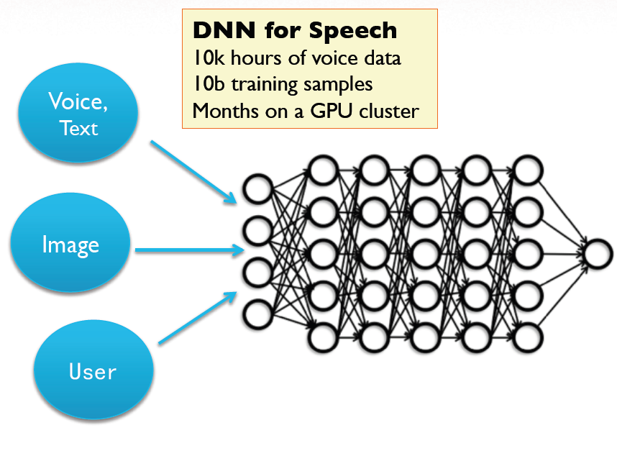
?

Slide 25
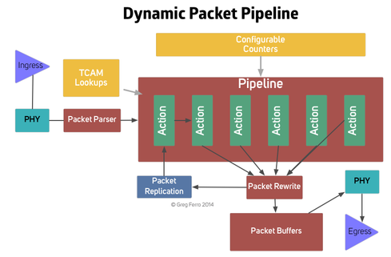
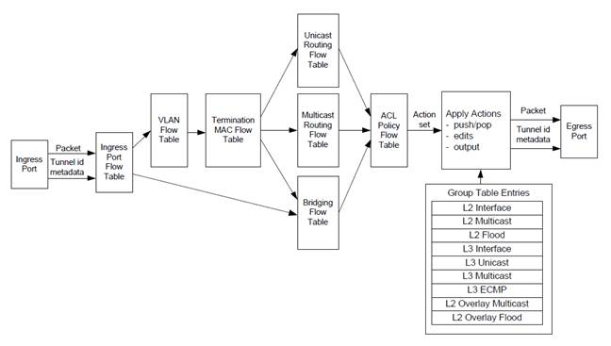
Networking (switching) ASIC Pipelines

Slide 26
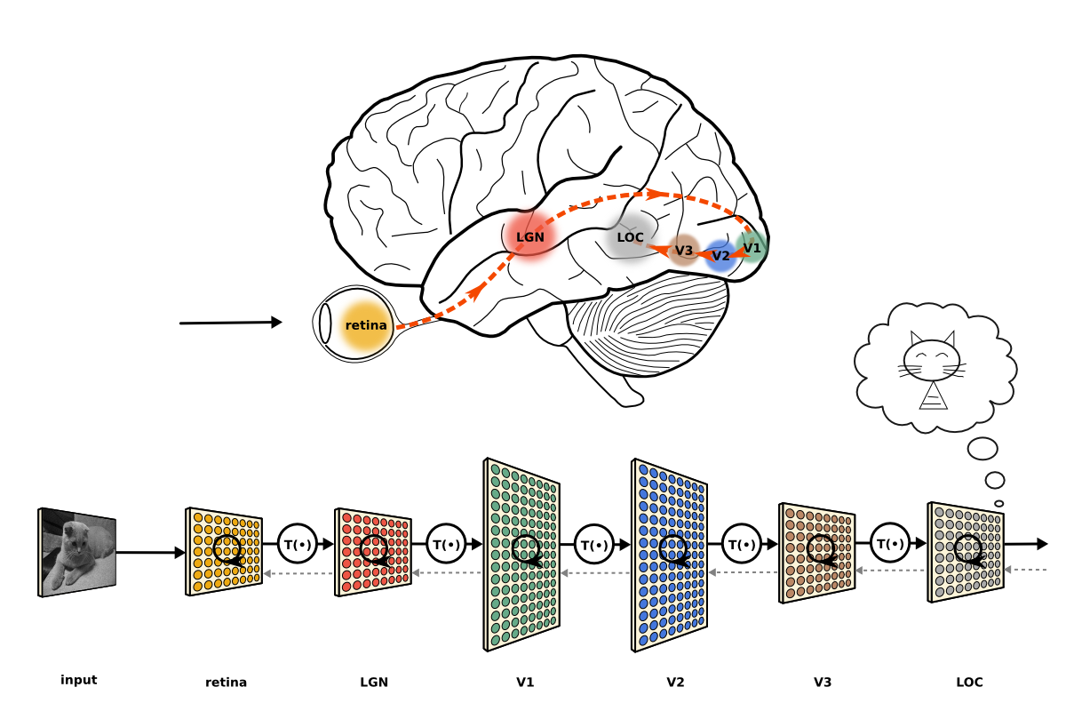
Thesis: Humans are Stream Engines!

Slide 27
References
Preliminaries: https://www.oreilly.com/ideas/the-world-beyond-batch-streaming-101
http://www.mmds.org
https://github.com/ddutta/streamsense

